Slide 1
A café takes £500 in cash sales in a day. At the end of the day, the till shows £500. But when the owner checks the bank deposit, only £480 was paid in. Where could the missing £20 have gone?
Notes:
Allow the learners a few minutes to read the hook slide as the group join the session.
Ask learners (2–3 mins):
Independently come up with as many possible explanations as you can.
Encourage both innocent errors (miscounting, wrong posting, bank fee) and fraudulent reasons (theft, skimming).
Debrief (2–3 mins):
Collect answers.

Slide 2

Before we begin, do you have any questions
Notes:
Any questions before the session starts

Slide 3


Accounts or Finance Assistant
Principles of Bookkeeping
Notes:
Instructions:
Level 2 Accounts or Finance Assistant: Theme 4, Bookkeeping Controls
-Briefly introduce yourself to the group and your background/ expertise relating to accountancy and finance.
-Encourage / ask all learners to have their cameras on if they able to.

Slide 4

Accounts or Finance Assistant
Bookkeeping Controls
Notes:
Instructions:
Level 2 Accounts or Finance Assistant: Theme 4, Bookkeeping Controls

Slide 5
Let’s take a look at what’s on today’s agenda.
There are two options for the Agenda introduction and Workshop agenda slides for you to choose. You can mix between the two so there are four options so long as the text is correct. Delete the others not needed.
Notes:
Instructions:
Use this slide to introduce the session agenda which follows on the next slide

Slide 6
Icebreaker
5 min
1
Session deliverables and housekeeping
45 min
2
Part 1: Control account detective
60 min
3
Part 2: Payroll and control accounts
45 min
4
Part 3: Bank reconciliation practical
45 min
5
Notes:
Instructions:
Update text as needed. Duplicate this slide if more rows are needed or delete rows if too many, no scaling required all is set as needed.
What to expect in today’s session?
Navigate through each point on what to expect in today’s session,

Slide 7
Medals and Missions
3 min
1
Questions and next steps
3 min
2
Notes:
Instructions:
Update text as needed. Duplicate this slide if more rows are needed or delete rows if too many, no scaling required all is set as needed.
What to expect in today’s session?
Navigate through each point on what to expect in today’s session,

Slide 8
Now let’s look at this workshop's deliverables.
Notes:
Instructions:
Use this slide to introduce the session agenda which follows on the next slide

Slide 9
Explain how control accounts help to ensure the accuracy of the ledger accounts and describe the relationship between a control account and its supporting detailed records.
1
Identify different scenarios where specific internal controls would be most effective in a bookkeeping system and explain why they are important for preventing errors or fraud.
2
Summarise the key information contained within payroll records and prepare a wages control account.
3
Notes:
Instructions
Add your workshop deliverables for the session. If you need more duplicate and add more slides, don’t add more to current slide.

Slide 10
Explain the purpose of a receivables control account reconciliation and a payables control account reconciliation.
4
Prepare receivable and payable control account reconciliations.
5
Distinguish between the receipts and payments sections of a cash book and explain how the cash book is used to track the movement of cash within a business.
6
Notes:
Instructions
Add your workshop deliverables for the session. If you need more duplicate and add more slides, don’t add more to current slide.

Slide 11
Explain the purpose of a bank reconciliation and describe common reasons for differences between the cash book balance and the bank statement balance.
7
Prepare a simple bank reconciliation statement given a cash book summary and a bank statement.
8
Recognise inconsistencies between provided invoice details and other transactional data and describe how these inconsistencies might indicate potential errors.
9
Notes:
Instructions
Add your workshop deliverables for the session. If you need more duplicate and add more slides, don’t add more to current slide.

Slide 12








Let’s create a focused, respectful, and engaging session through a few housekeeping rules
This is to be used for remote sessions only (Delete if not applicable)
Discussions and debate
Regular breaks
Using the chat box
Group work and feedback
Mute microphone
Have webcam on
Questions or comments
Notepad and pen
Notes:
Housekeeping
Go through or recap the housekeeping expectation of the session
Regular breaks
Group work and feedback
Notepad and pen
Discussions and debate
Mute microphone
Use hand feature for any questions or comments
Using the chat box
Have webcam on

Slide 13

True or false: Accounting edition
Reconciling accounts is only done at year-end.
Bank charges always appear in the cash book automatically.
Payroll control accounts should balance to zero once postings are complete.
Unpresented cheques cause the cash book and bank statement to differ.
A control account shows the balance for one single customer.
?
?
?
?
Notes:
Instruction - Icebreaker
Read out quick statements about bookkeeping, internal controls and reconciliations.
Learners add to the chat a thumbs up/down for true/false.
Ask learners to explain their answers.
Examples:
“A control account shows the balance for one single customer.” → False (it’s the total).
“Bank charges always appear in the cash book automatically.” → False (must be added when noticed on bank statement).
“Payroll control accounts should balance to zero once postings are complete.” → True.
“Unpresented cheques cause the cash book and bank statement to differ.” → True.
“Reconciling accounts is only done at year-end.” → False (done regularly).
Could you make this activity more involved by having the trainer call on learners to explain their answers for both true and false?

Slide 14
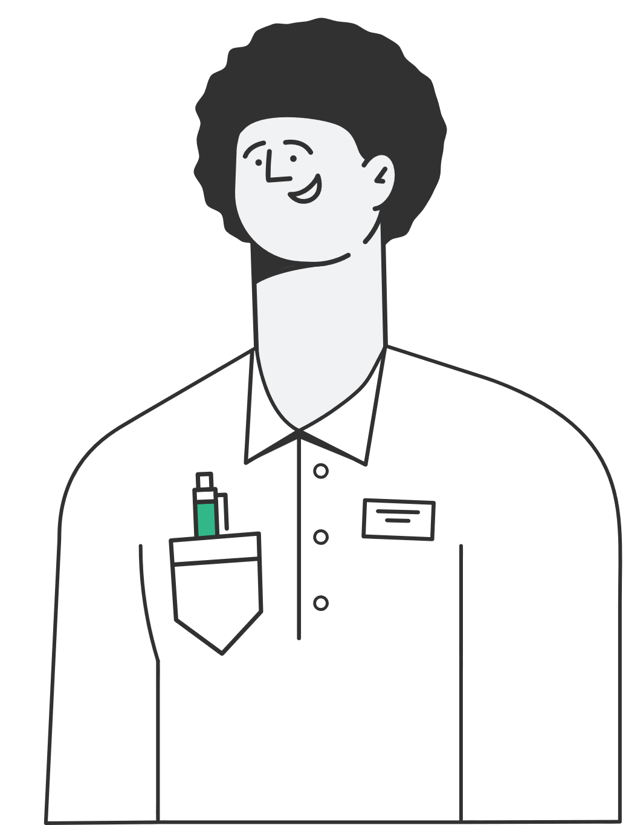
Part 1 – Control account detective
45 min
Tasks
What is a control account?
1
Match the scenario with the correct check
2
Receivable and payables control account detective
3
Notes:
The intent of this activity is: To explain why control accounts matter, identify common internal controls and demonstrate reconciliation skills that help safeguard accuracy in bookkeeping.

Slide 15


What is a control account?
3 min
Summary account for example
Receivables = total owed by all customers).
Supports accuracy checks against detailed ledgers.
Helps detect errors, fraud and omissions.
Notes:
Get learners to think independently what a control account is.
Cold call on learners to see what they think. After this click through the animations.

Slide 16
Match each of the scenarios with the correct control.
(10 mins)
You’ve added up a stack of invoices and the total doesn’t match the sum entered in the system.
1
Ten purchase invoices are totalled before entering into the purchases day book to ensure none are missing.
2
Batch check
Reconciliation
The Receivables Control Account shows £25,000, but when you add up all the individual customer accounts you only get £24,500.
3
Arithmetical
check
Audit
The cash book shows £10,250, but the bank statement shows £9,950.
4
Bank reconciliation
An external accountant reviews the company’s financial records to provide independent assurance.
5

Slide 17

Task A – Receivables control account detective (20 mins)
In your groups:
Prepare the Receivables Ledger Control Account for May 2025 using the summary totals from the daybooks.
1
Compare the closing balance with the total of the customer balances at 31 May 2025.
2
Reconcile the two and explain any difference.
3
20 min
Notes:
Workbook pages:
Learners prepare receivables control account (data set provided in excel document) in break out rooms. You will need to put the learners into groups of 3-4.
Learners will compare to customer balances.
Spot difference & discuss what may have caused it.
Answers are on the tabs but have been hidden.

Slide 18


Task B – Payables control account detective (15 mins)
In your groups:
Repeat with Payables Control Account + suppliers.
1
15 min
Notes:
Workbook pages:
Put learners into breakout rooms again to complete the tab on Payables.
After 10 mins – groups reconvene
Debrief –
Difference means something’s missing, duplicated or in the wrong place.
Receivables example → could be a missing invoice or bad debt.
Payables example → in this case, missing discount in control account.
Internal controls catch these before financial statements are published .

Slide 19



Part 2 – Payroll and control accounts
60 min
Tasks
Key formulas
1
Worked example
2
Group task – Janet’s Crochet Emporium
3
Notes:
The intent of this activity is: Apply payroll knowledge to control accounts.
Mini recap on payroll terms
Key formulas
Worked example together
Group task – Janet’s Crochet Emporium

Slide 20
Pay records, what’s included?
5 min
Gross Pay (wages before deductions)
PAYE (Income Tax)
National Insurance (Employee & Employer)
Pension Contributions (Employee & Employer)
Other deductions (for example union fees, loans)
Net Pay (what staff actually receive)
Wages Expense (total cost to employer)
Notes:
Get learners to think independently what a control account is.
Cold call on learners to see what they think. After this click through the animations.

Slide 21


Task 1 - Calculations
Wages expense = Gross Pay + ______ + ______
HMRC liability = PAYE + ______ + ______
Pension liability = ______ + ______
Net pay = Gross pay – (income tax + ______ + ______ + other deductions)
10 min
Notes:
Instruction
Workbook pages:
Learners fill blanks independently
Go through answers and check understanding

Slide 22

Task 2 - One worked example together
“Gross pay £1,000, PAYE £200, ER NI £50, EE NI £40, ER Pension £25, EE Pension £25, Union £10.”
Wages expense
HMRC liability
Pension liability
Net pay
Place items in wages control account
10 min
Notes:
Instruction
Ask learners for each step (don’t give answers too quickly)
Write calculations visibly:
Wages expense = 1,000 + 50 + 25 = £1,075
HMRC liability = 200 + 40 + 50 = £290
Pension liability = 25 + 25 = £50
Net pay = 1,000 – (200+40+25+10) = £725

Slide 23
Task 3 - Group task: Janet’s Crochet Emporium
Apply the same method to Janet’s Crochet Emporium payroll data in the excel document
Work in groups (30 mins)
Present your answers back to group
30 min
Notes:
Instruction
Learners attempt Janet’s Crochet Emporium scenario (larger numbers)
Put learners into mixed ability groups – breakout rooms
Circulate to support groups
After 30 mins groups share results
Revisit formulas and stress application > arithmetic
Extension / discussion questions
What might happen if an entry is posted incorrectly?
What risks does this create for HMRC reporting, staff pay or business costs?
How does the Wages Control Account help prevent errors?

Slide 24
Let’s take a quick break!
5 mins
Feel free to stretch, grab a drink, and we’ll be back shortly!
Notes:
Break

Slide 25

Part 3 – Bank reconciliation practical
45 min
Tasks
Cash book and bank statement
1
Trainer led example 1
2
Group task on some example data
3
Notes:
The intent of this activity is: build learners’ practical skills and confidence in reconciling a business’s cash book with its bank statement, a key control process in accounting.

Slide 26
Using the cash book & bank statement
Cash book
  Records all business receipts (Debit) and payments (Credit).
Bank statement
  Bank’s record of transactions.
  Running balance shows cash/bank available.
  May differ from Cash Book due to timing, charges, or omissions.
Reconciliation
  Process to explain and resolve differences.
  Ensures Cash Book matches Bank Statement.
Notes:
Define clearly:
Cash book receipts = money in (sales, customer payments).
Cash book payments = money out (suppliers, wages, direct debits).
Bank statement = bank’s version of events.

Slide 27
Practical – Reconcile two bank/cash book examples – Follow the steps
Find differences
1
List unpresented cheques (deduct from bank)
2
List outstanding lodgements (add to bank)
3
record bank charges/credits in cash boo
Record bank charges/credits in cash book
4
Notes:
Display Excel sheet on screen. Show learners:
Opening balances (Bank £3,752 vs Cash Book £3,652).
Closing balances (Bank £2,947 vs Cash Book £3,003).
Ask: “Why might there be differences?” Gather ideas → (cheques not cleared, outstanding lodgements, bank charges, missing entries).
Trainer-led walkthrough of the first example
Summarise the process:
Start with bank statement closing balance.
Deduct unpresented cheques.
Add outstanding lodgements.
Update cash book with bank charges, direct debits, credits.
Confirm reconciled balance = cash book.
Display a simple checklist on slide:
Have all cheque numbers been matched?
Have all bank charges and direct debits been entered?
Have receipts been recorded in both places ?
Go through example 2 with the learners working on this as a whole group. Trainer to facilitate a discussion around the steps involved.

Slide 28
Check opening balance mismatches.
5

Slide 29
Medals and missions
&
Medals
Missions
Medals represent what you have achieved or done well in the workshop.
Missions are areas you aim to improve or focus on in
the future.
Notes:
Instructions:
Remind learners of the purpose of medals and missions. This is an activity that is designed to help them reflect on their achievements from today’s session (medals) and identify future goals and actions based on today’s session (missions).
This can be completed after the session by the learner, and uploaded to the relevant Bud activity, to validate learning and close down the Bud activity.
Instruct learners to go onto their Bud accounts and download the medals and missions handout. This can be found in the programme launch workshop activity. Ask learners to complete the handout and upload it to Bud after this workshop. This will usually take around 10 to 15 minutes.
If time allows, ask for one or two volunteers to share a medal or mission that is top of their mind before moving on.
Wider Skills: CEIAG
Explain to learners that this technique allows them to identify areas for improvement that may be relevant to their career goals and aspirations. It provides a structured framework for discussing how their learning experiences aligns with their career aspirations. Encourage them to think about how they might use this tool in their capacity of managing operations.

Slide 30
Explain how control accounts help to ensure the accuracy of the ledger accounts and describe the relationship between a control account and its supporting detailed records.
1
Identify different scenarios where specific internal controls would be most effective in a bookkeeping system and explain why they are important for preventing errors or fraud.
2
Summarise the key information contained within payroll records and prepare a wages control account.
3
Notes:
Instructions
Add your workshop deliverables for the session. If you need more duplicate and add more slides, don’t add more to current slide.

Slide 31
Explain the purpose of a receivables control account reconciliation and a payables control account reconciliation.
4
Prepare receivable and payable control account reconciliations.
5
Distinguish between the receipts and payments sections of a cash book and explain how the cash book is used to track the movement of cash within a business.
6
Notes:
Instructions
Add your workshop deliverables for the session. If you need more duplicate and add more slides, don’t add more to current slide.

Slide 32
Explain the purpose of a bank reconciliation and describe common reasons for differences between the cash book balance and the bank statement balance.
7
Prepare a simple bank reconciliation statement given a cash book summary and a bank statement.
8
Recognise inconsistencies between provided invoice details and other transactional data and describe how these inconsistencies might indicate potential errors.
9
Notes:
Instructions
Add your workshop deliverables for the session. If you need more duplicate and add more slides, don’t add more to current slide.

Slide 33
What to expect in your next workshop
Recording and classifying transactions
1
Trial balance and error checking
2
Correcting errors and professional practice
3
Notes:
Instructions
*This slide covers what is coming soon in the next workshop. Click to reveal.

Slide 34
Well done for completing the first workshop of your course
Let’s see what the next steps in your journey are
This and next slide are linked, so this is like the header on its own as a positive statement
Notes:
Next steps

