Slide 1
Accountancy L2 – self paced
Communication - Communication in accountancy | Review 360
Bookkeeping - Rise 360. Bookkeeping part 2 | Review 360
Digital Technology - AP-AFA Digital Technology | Rise 360

Slide 2
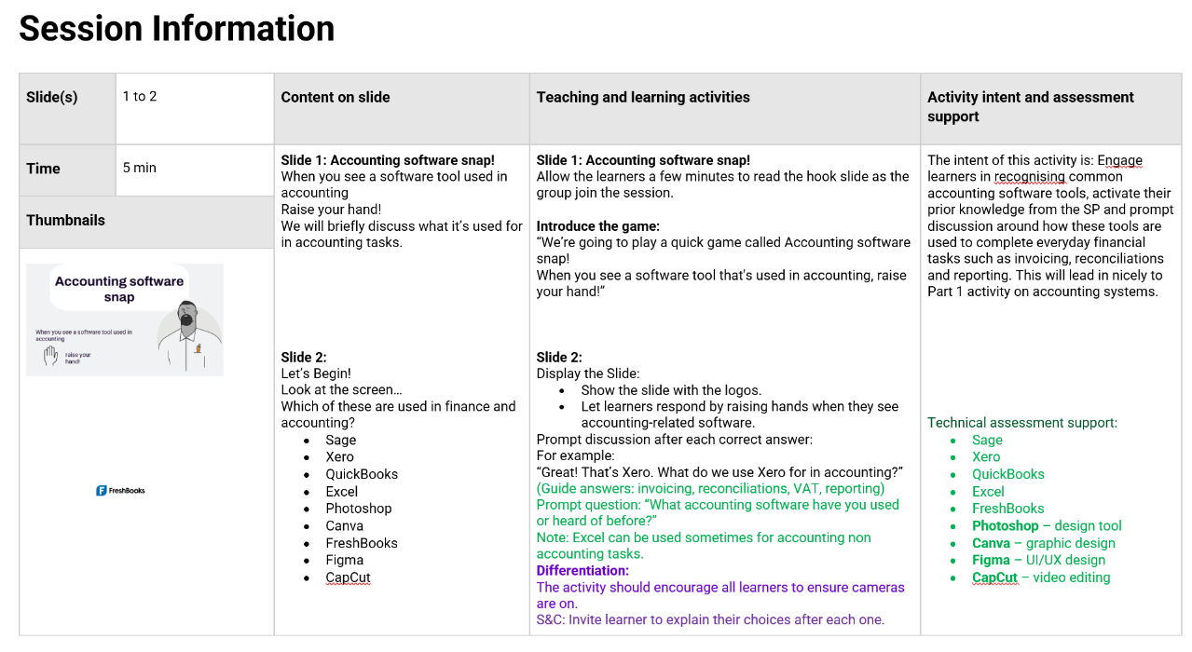
Workshops

Slide 3
